Slide 1
Symbolic Execution of Complex Program Driven by Machine Learning Based Constraint Solving
Xin Li, Yongjuan Liang, Hong Qian, Yi-Qi Hu,
Lei Bu, Yang Yu, Xin Chen, and Xuandong Li
State Key Laboratory for Novel Software Technology Department of
Computer Science and Technology Nanjing University,
Nanjing, Jiangsu, P.R.China

Slide 2
Outline
Introduction
Related Work
Technique
Implementation
Experimentation & Evaluation
Conclusion

Slide 3
Introduction
Symbolic Execution
It is a means of analyzing a program to determine what inputs cause each part of a program to execute.
Pex
JPF

Slide 4
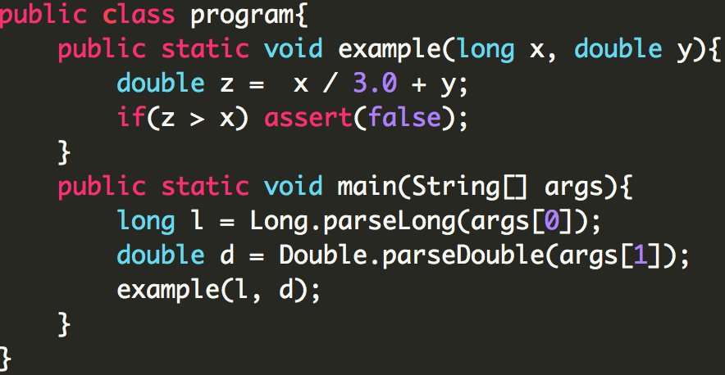
Introduction
Symbolic Execution
Program
PathCondition
Solver

Slide 5
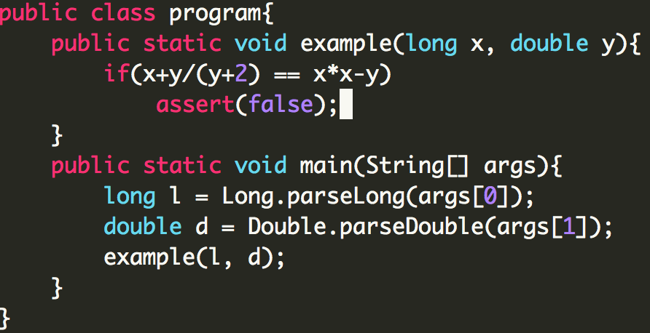
Introduction
Challenge 1: nonlinear arithmetic operation
Program
PathCondition
Solver

Slide 6
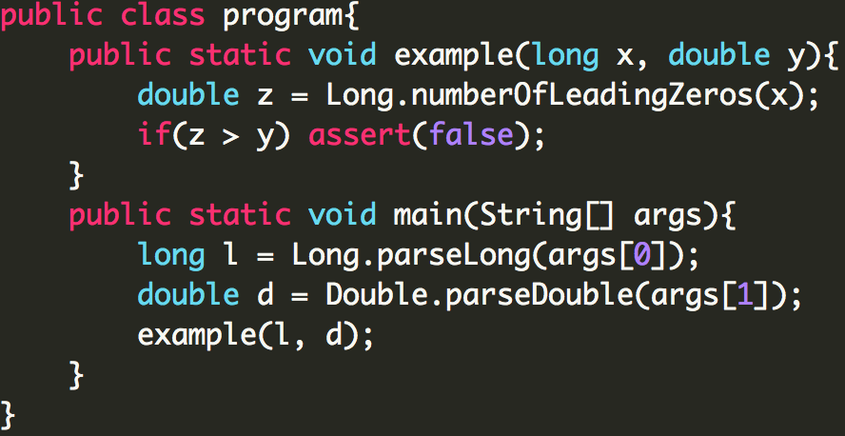
Introduction
Challenge 2: library method operation
Program
PathCondition
Solver

Slide 7
Related Work
Strong SMT solvers
iSAT and Z3
Simplification-based approaches
jCUTE and SPF-Mixed
Search-based approaches
Coral and CW

Slide 8
Technique
Constraint Solving
Minimize the
dissatisfaction degree
Optimization Problem

Slide 9
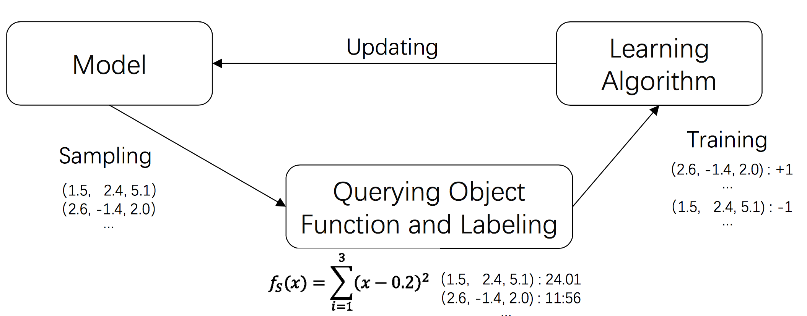
Technique
Derivative-free Methods
use only the information of solution evaluations
Dissatisfaction rate
Library method PC
Notes:
To overcome the limitations of the classical symbolic execution, our work tries to adapt a new machine learning algorithm RACOS. RACOS has a solid theoretical foundation for complex optimization problems. It basically samples solutinos from a learning model, updates the model from the feedback of the solutions, and continues this iteration to find better solutions.

Slide 10
Technique
Derivative-free Methods
Use only the information of solution evaluations
Consists of an iteration 2 key steps
Sample solutions from a model
Update the model from the objective function values of the sampled solutions
RACOS^{[1]}
It employs a hyper-rectangle classifier as its model
It has high efficacy and high efficiency
It has no parameters to adjust.
[1] Yu, Y., Qian, H., and Hu, Y.-Q. Derivative-free optimization via classification. In AAAI (2016), pp. 2286–2292

Slide 11
Technique
Dissatisfaction rate
It is used to measure how badly a sample violates the constraint.
It transforms the feasibility problem of a path condition into an optimization problem.
Dissatisfaction Rate 𝐷𝑖 for each constraint 𝐶𝑖
Dissatisfaction Function

Slide 12
Technique
Dissatisfaction rate
Example: x = -1; y = 2
Path condition
pow（x，3）< 0
sinx > 1-cosy
x + y == 3
Dissatisfaction rate
d=-3 -> 0
d=-2.2 -> 2.2
d=-2 -> 2
Dissatisfaction function
0+2.2+2 = 4.2

Slide 13
Technique
Dissatisfaction rate
Domain problem
Domain related PC
log(x+y) < 0
x = -2;y = 1
NaN
arcsin(x/y) < 0
x = 1;y = 0
Exception：div by 0
Path conditions
x / y > 0
pow(x,y)
log(x); sqrt(x); log10(x)
arcsin(x); arccos(x)
Domain related PC
y != 0
!((x == 0 && y <= 0) || (x < 0 && y – floor(y) != 0))
x > 0
x <= 1 && x >= -1

Slide 14
Technique
Library method PC
Each library method call is presented as an uninterpreted constraint.
Function name is treated as the uninterpreted operator.
Input arguments of the function call constitute the symbolic variables.
Example: x = 454
Path condition
Long.numberOfLeadingZeros(x)> x
Method Call
Dissatisfaction rate
abs(55 – 454) = 399

Slide 15
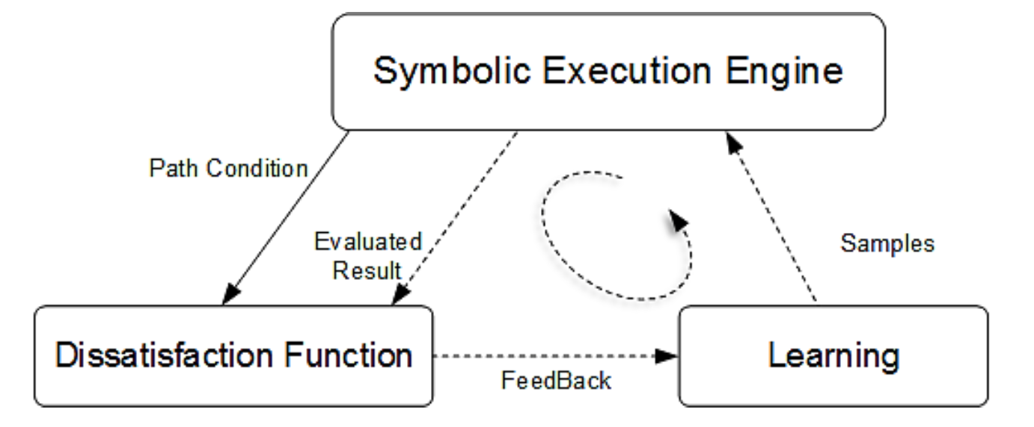
Technique
Machine Learning Based Symbolic Execution

Slide 16
Technique
MLB^{[1]}
Adapts the classical symbolic execution framework with a new machine learning based solving, RACOS.
Transform the feasibility problem of the path condi- tion to optimization problem by Dissatisfaction function
Generate the domain related PC to avoid the program exceptions.
Enrich the path condition by encoding library method calls as uninterpreted path conditions
^{[1] https: //github.com/MLB-SE}

Slide 17
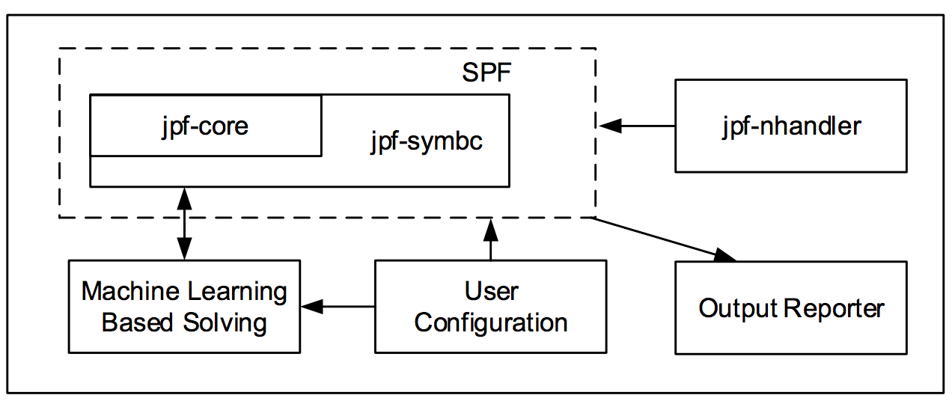
Implementation
MLB Tool Architecture

Slide 18
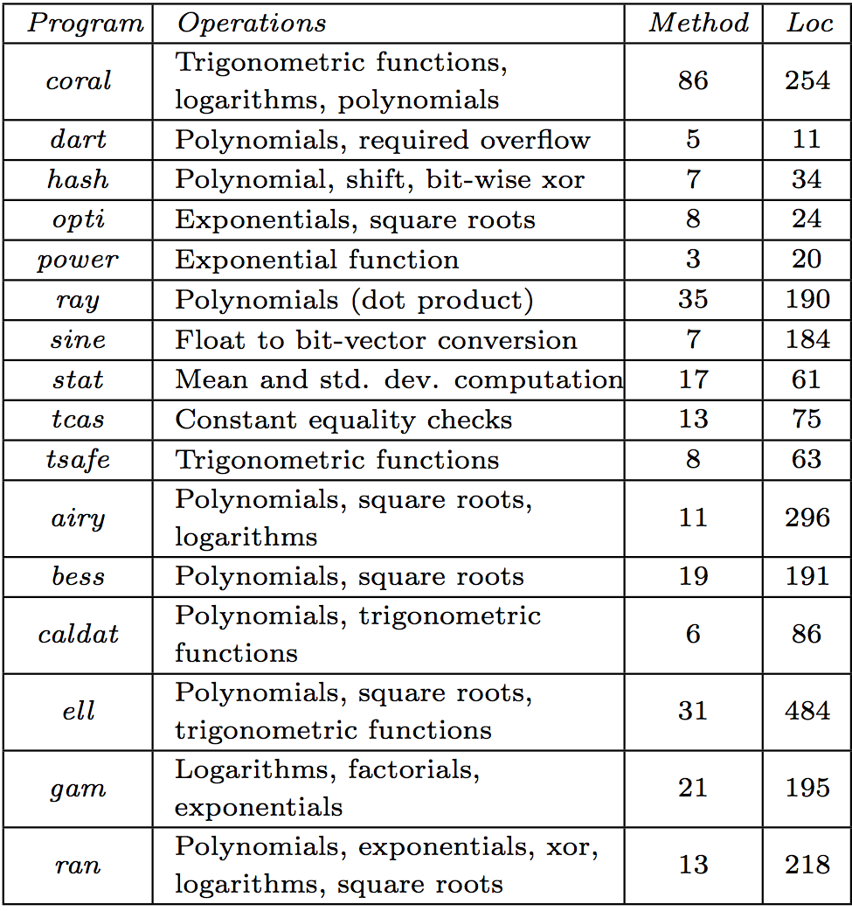
Experiment & Evaluation
Benchmark:
16 programs with 290 methods
Nonlinear operations, float point arithmetic, native method calls, etc.

Slide 19
Experiment & Evaluation
Competitor:
4 state-of-the-art tools
jCUTE, SPF-Mixed, SPF-CORAL, Concolic Walk

Slide 20
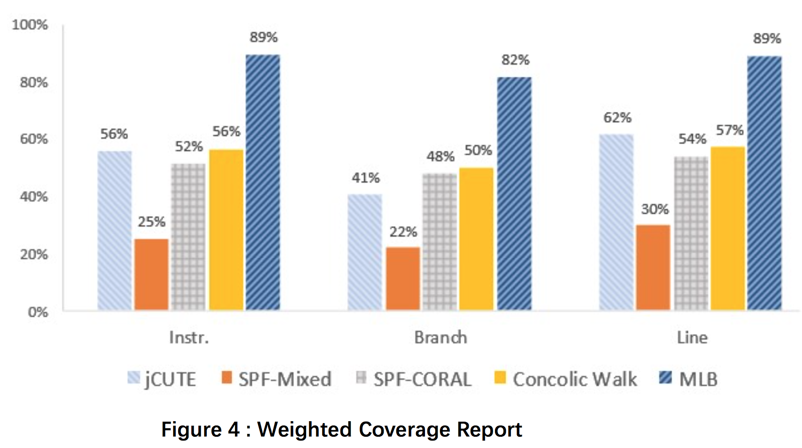
Experiment & Evaluation
Effectiveness Analysis：
Weighted coverage reports

Slide 21
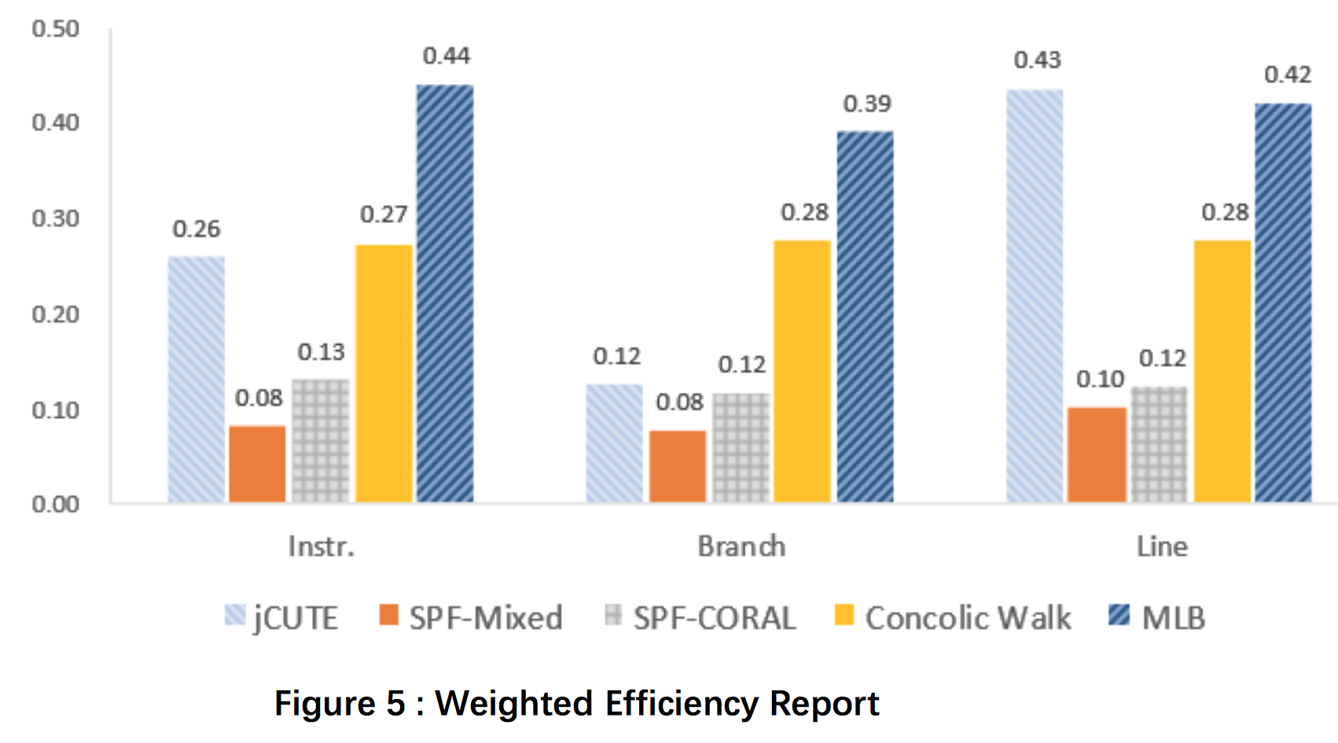
Experiment & Evaluation
Efficiency Analysis：
Weighted efficiency reports

Slide 22
Conclusion
Our Idea :
Adapting the machine learning based optimization technique into the classical symbolic execution framework.
Advantages:
Supporting linear path conditions, nonlinear operation, and even black-box library methods, etc.
Achieving both greater efficacy and efficiency.

Slide 23
Thanks
Q&A

